Slide 1
CNN HW Dataflow
2024.07.25 (목)
민한율 한이음 발표자료

Slide 2
Index
CONV Layer
BatchNormalization
Conv2D
Input Data
Data Type
Quantization
INT8 Data Flow

Slide 3
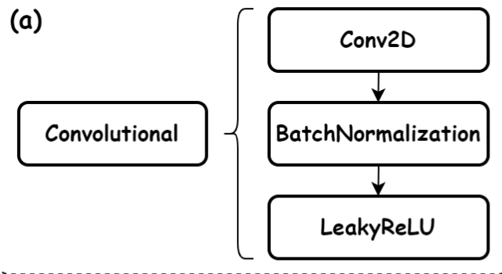
About CONV Layer
Structures of Convolutional Layer

Slide 4
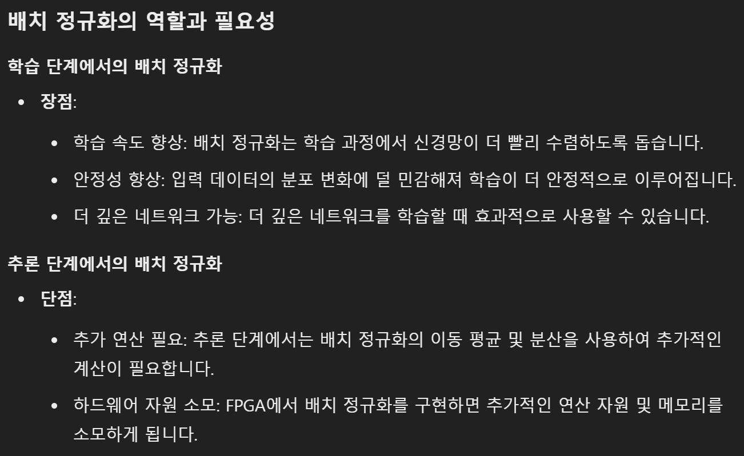
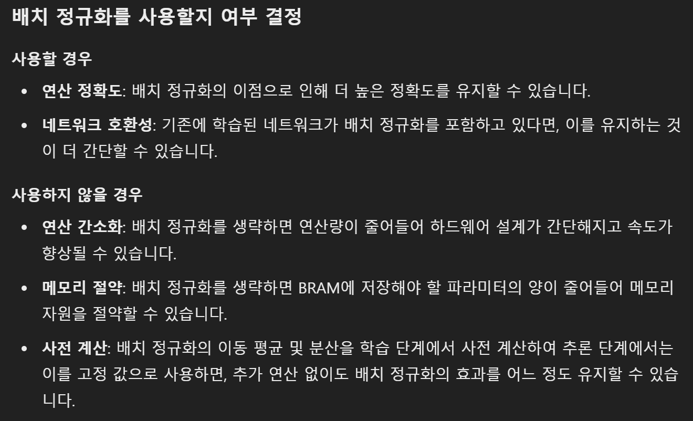
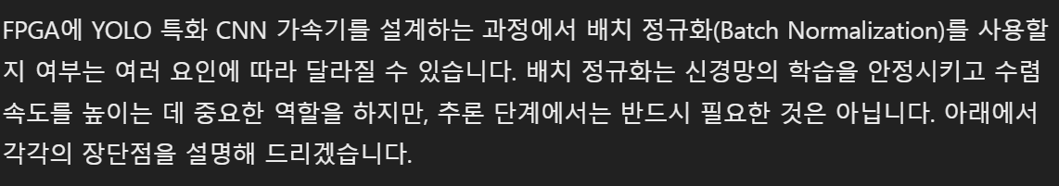
(1) About BatchNormalization

Slide 5
(1) About BatchNormalization
Weights_Summary_Corrected.xlsx 추가 자료 참고 빨간 박스가 BatchNorm File

Slide 6
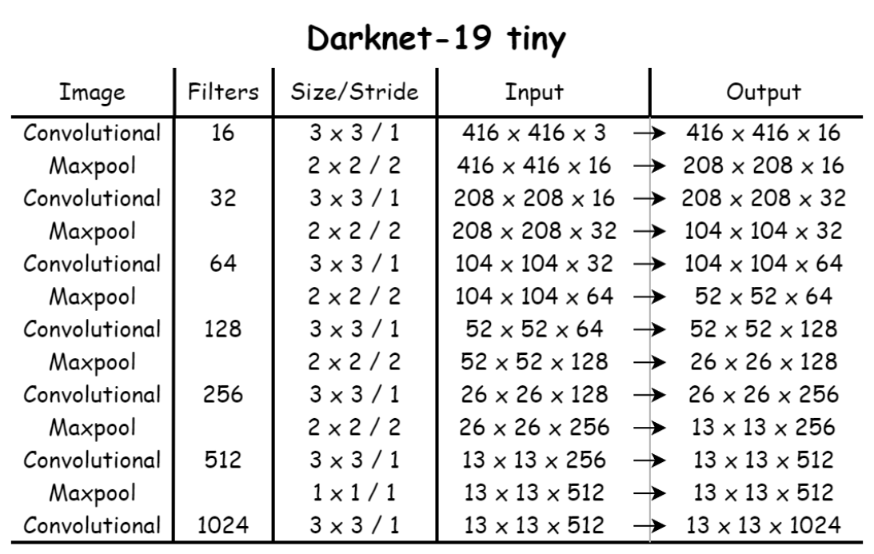
(2) About Conv2D
Example

Slide 7
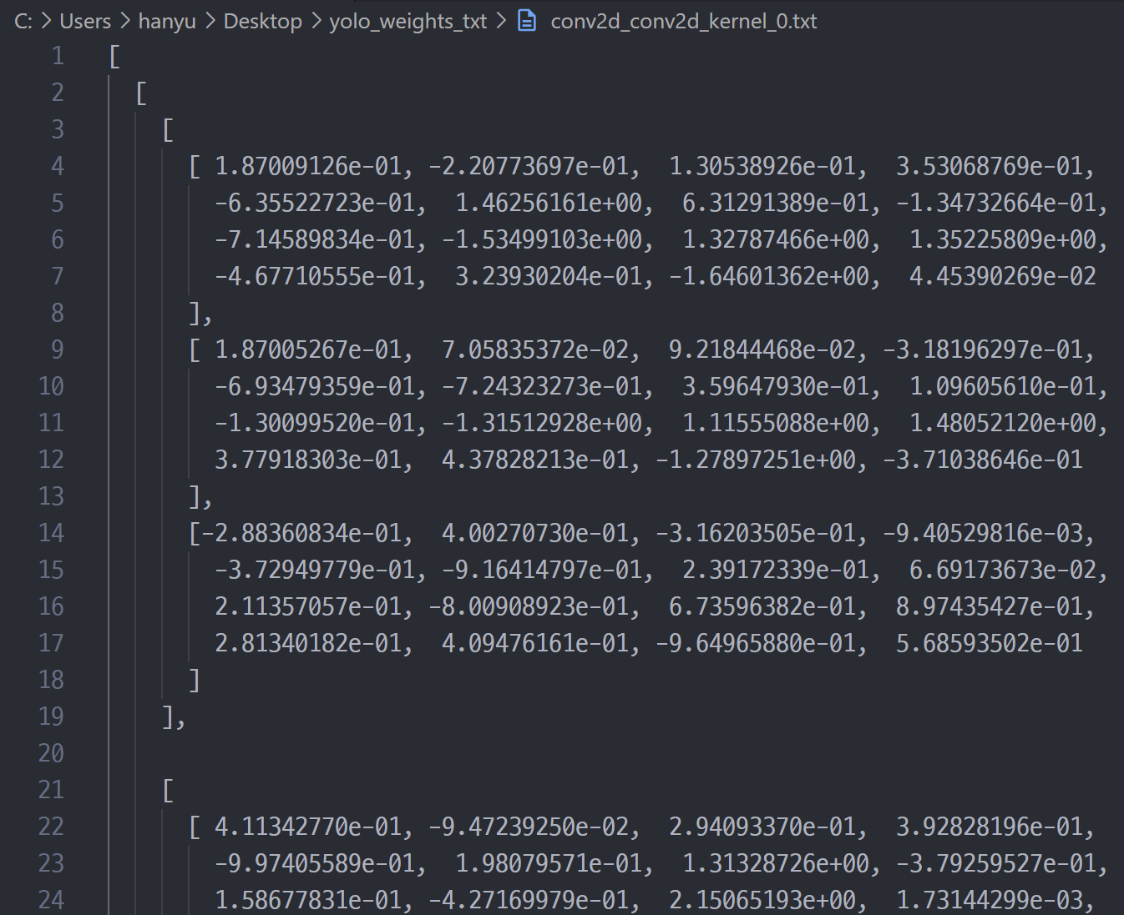
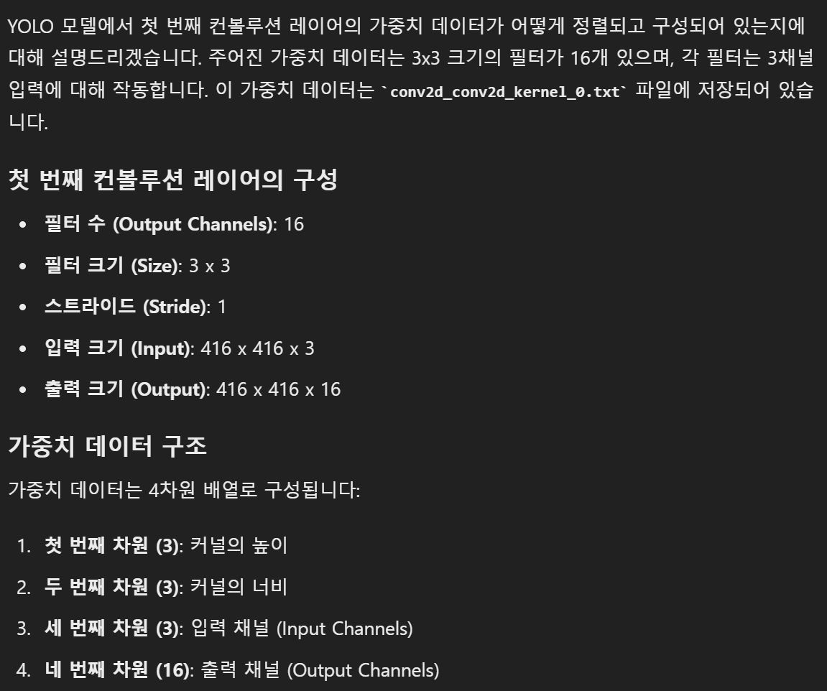
(2) About Conv2D
conv2d weight 중 일부

Slide 8
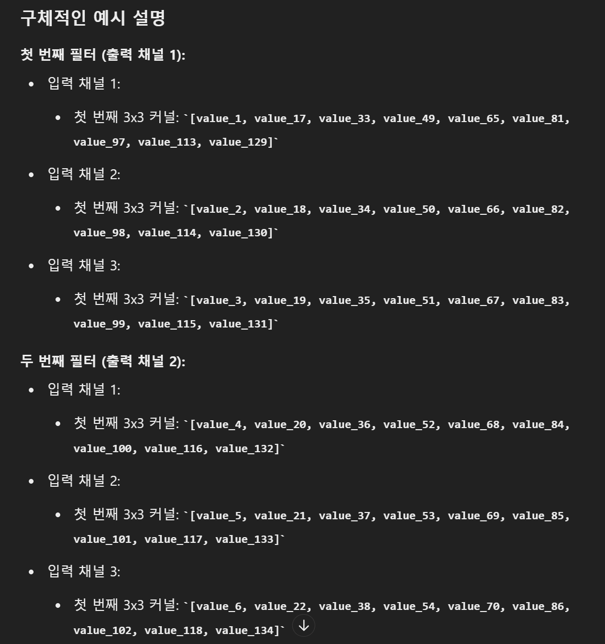
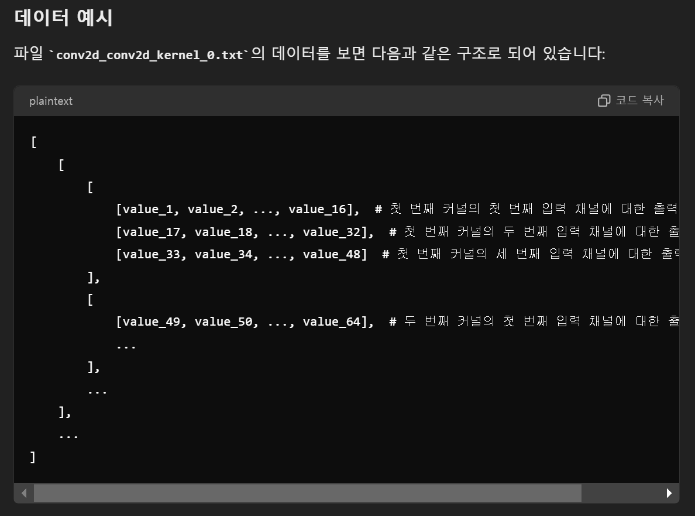
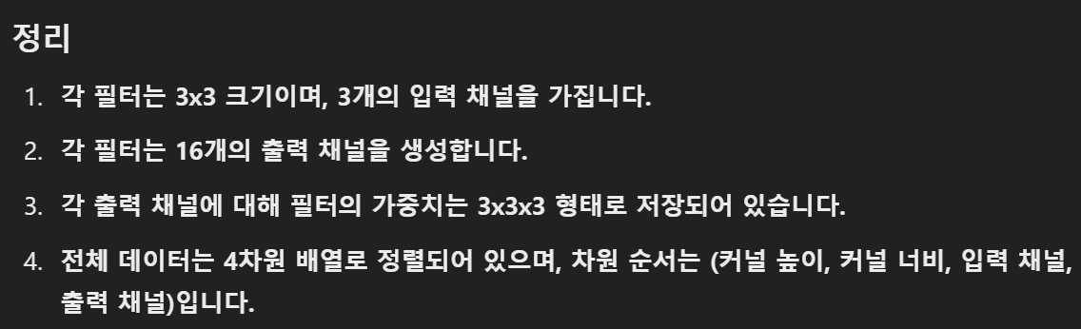
(2) About Conv2D

Slide 9
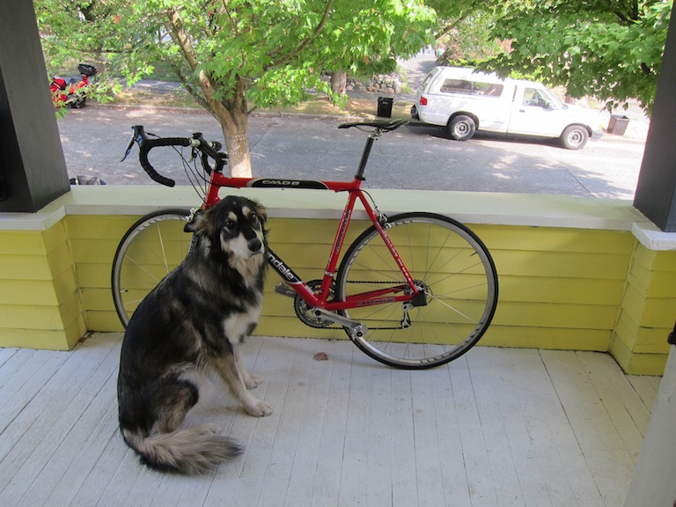
(3) About Input Data
DATA

Slide 10
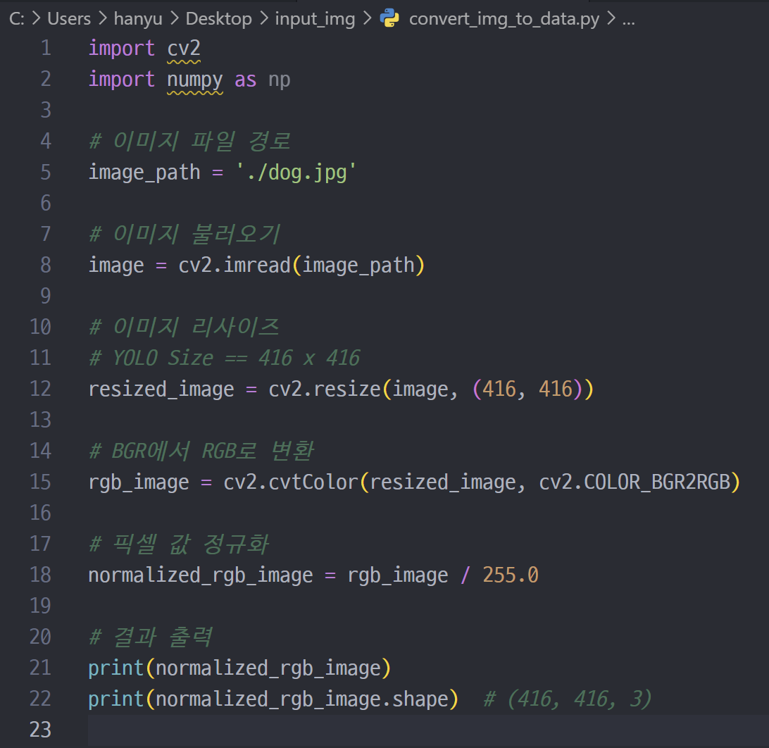
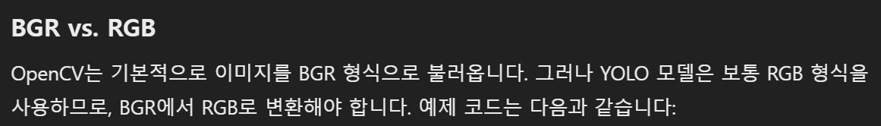
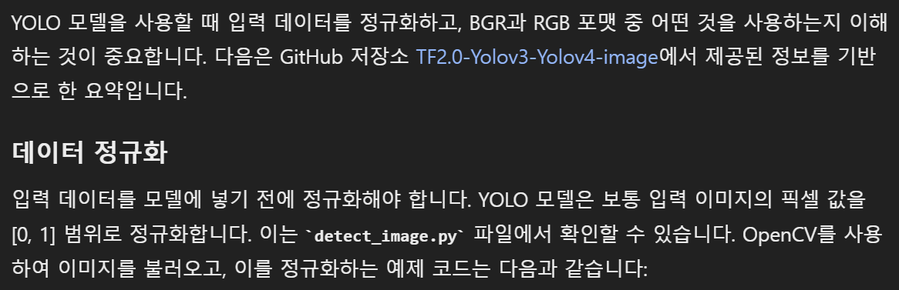
(3) About Input Data
참고 자료 input_img 폴더 참조
Reference Code in Python

Slide 11
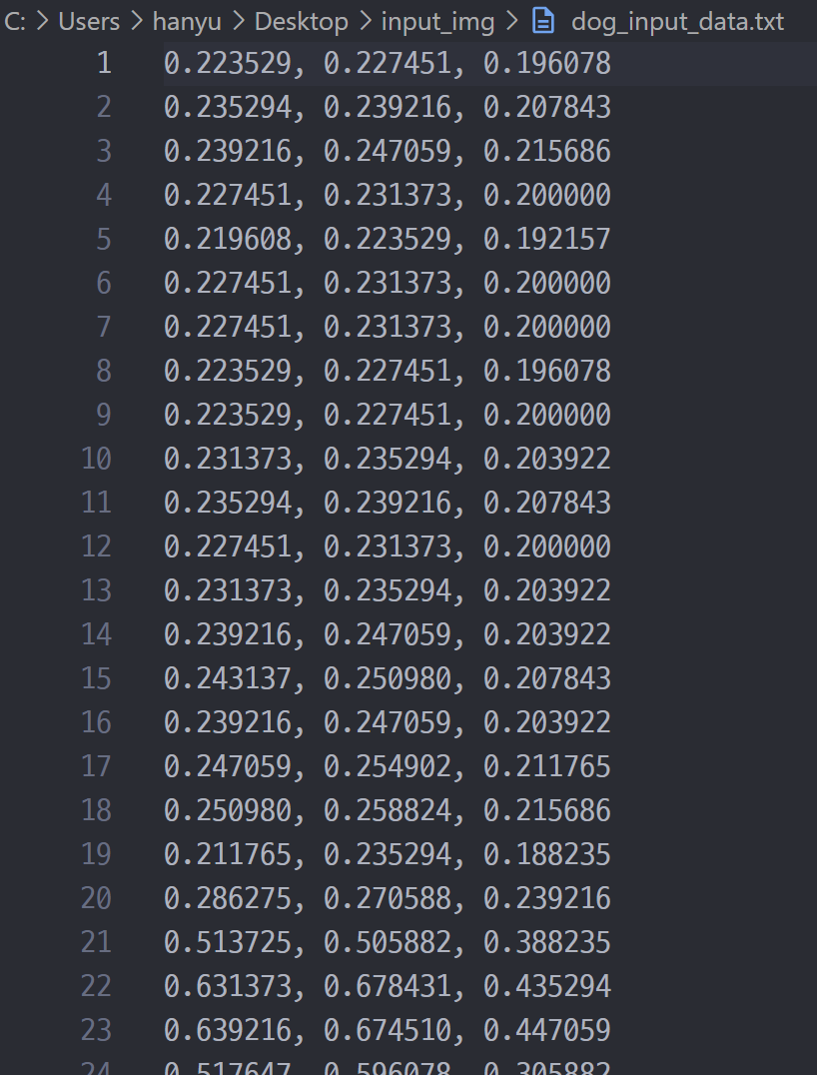
(3) About Input Data
1 pixel [ R, G, B ]
Output

Slide 12
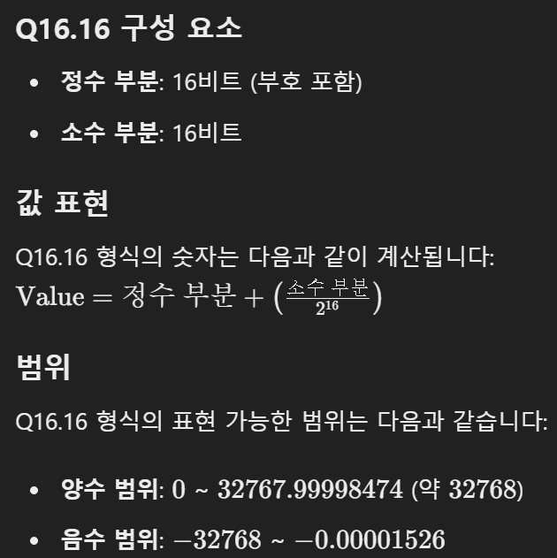
(4) About Data Type
INT8
FP32 (Fixed)
FP32 (Floating)
Mapping range
INT8: -128 ~ 127
FP32: 아래 사진 참고 (Q16.16 기준)

Slide 13
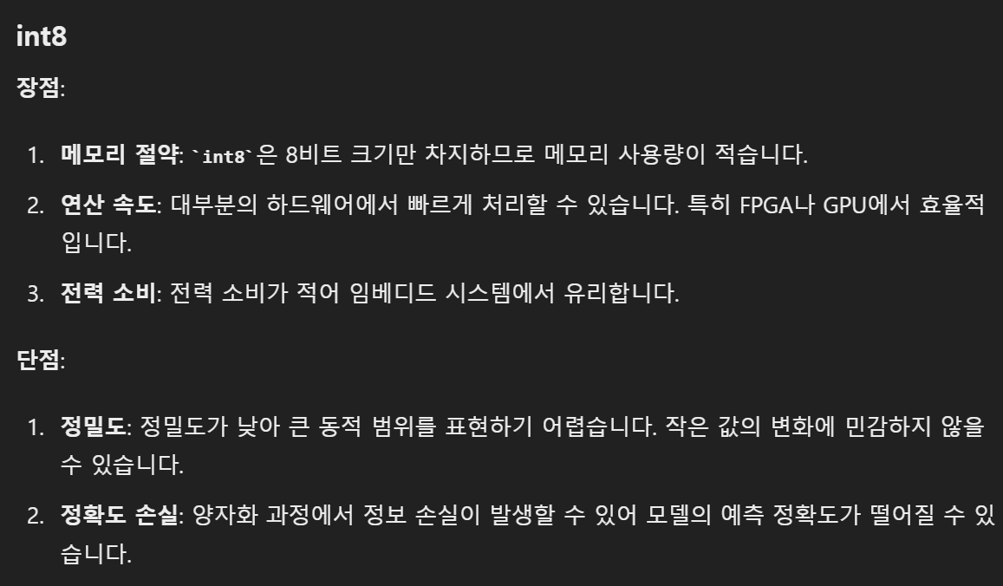
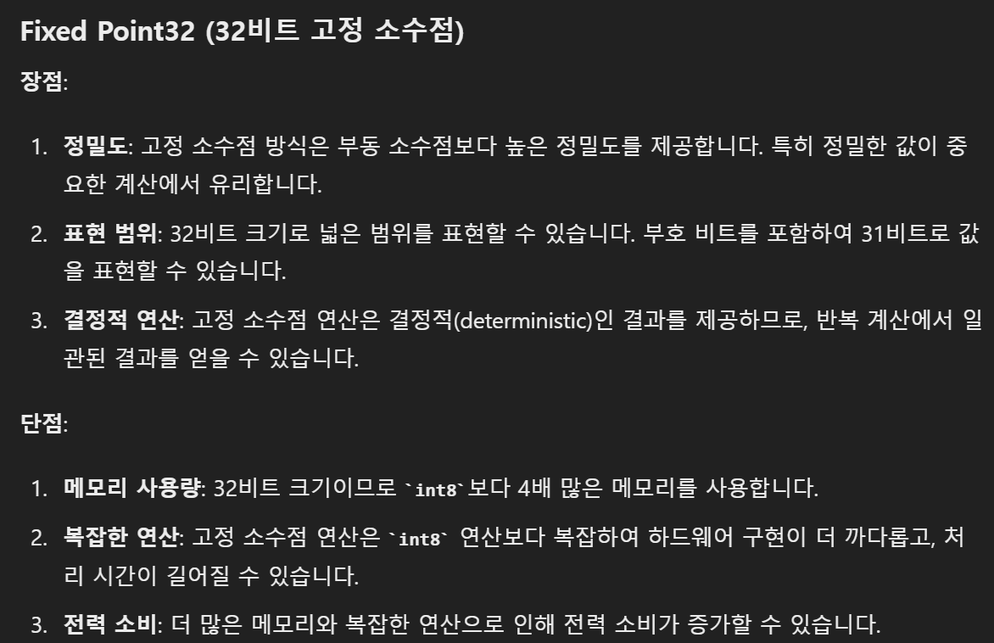
(4) About Data Type
INT8 vs FP32

Slide 14
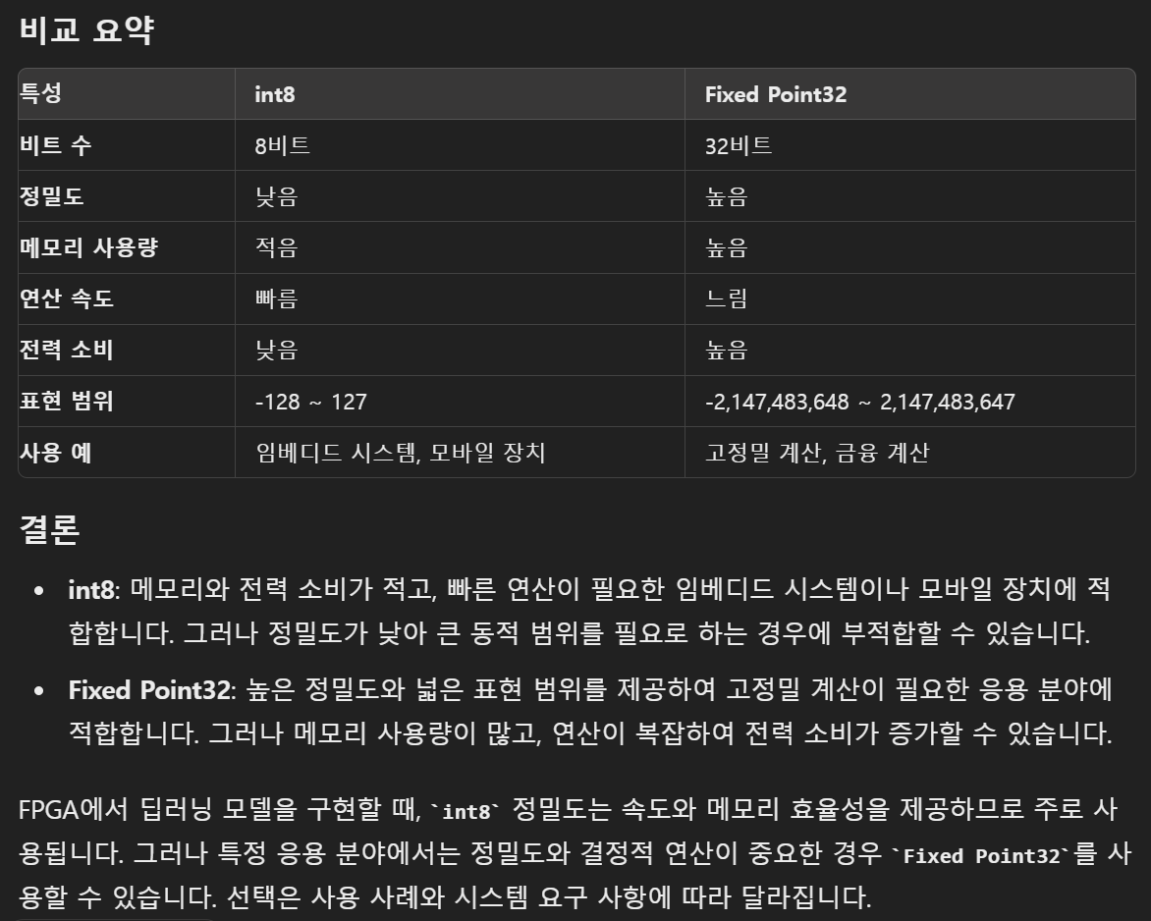
(4) About Data Type
INT8 vs FP32

Slide 15
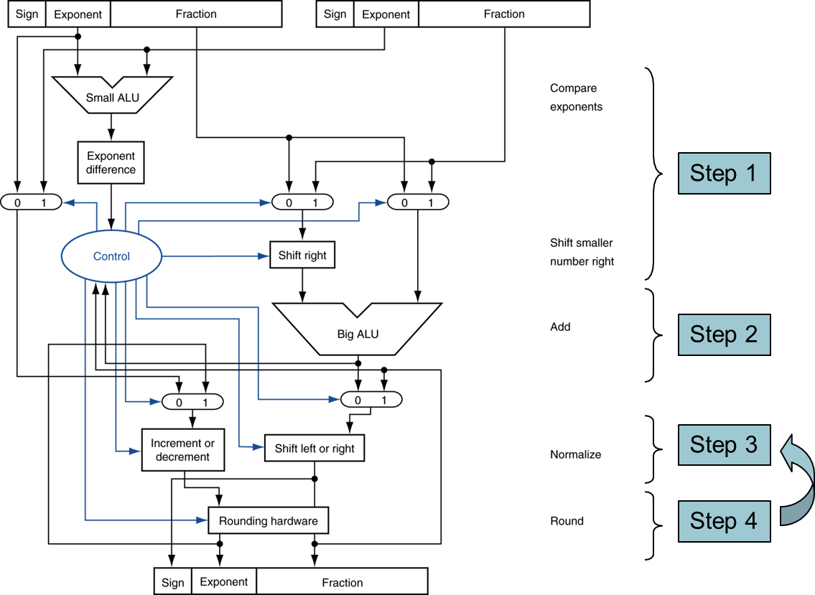
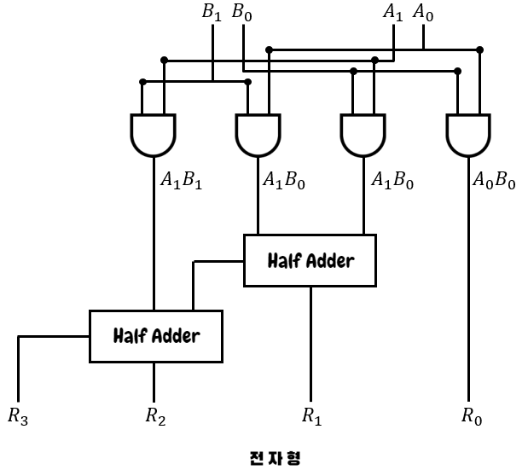
(4) About Data Type
INT8 vs FP32 (Floating Point) 곱셈기 비교
VS

Slide 16
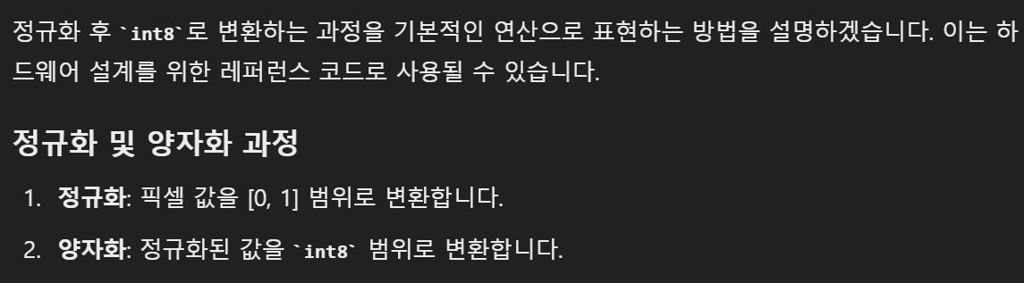
(5) About Quantization
How to convert Data type??
“Quantization!!”

Slide 17
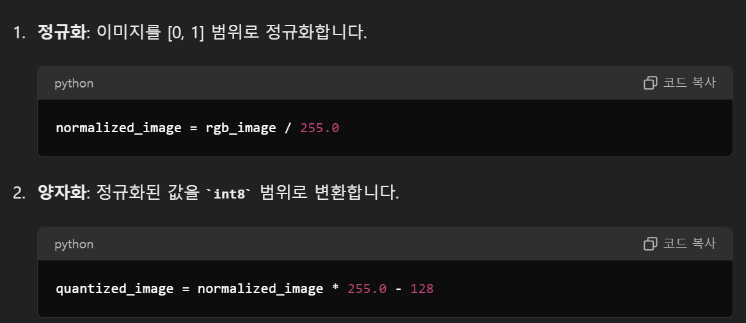
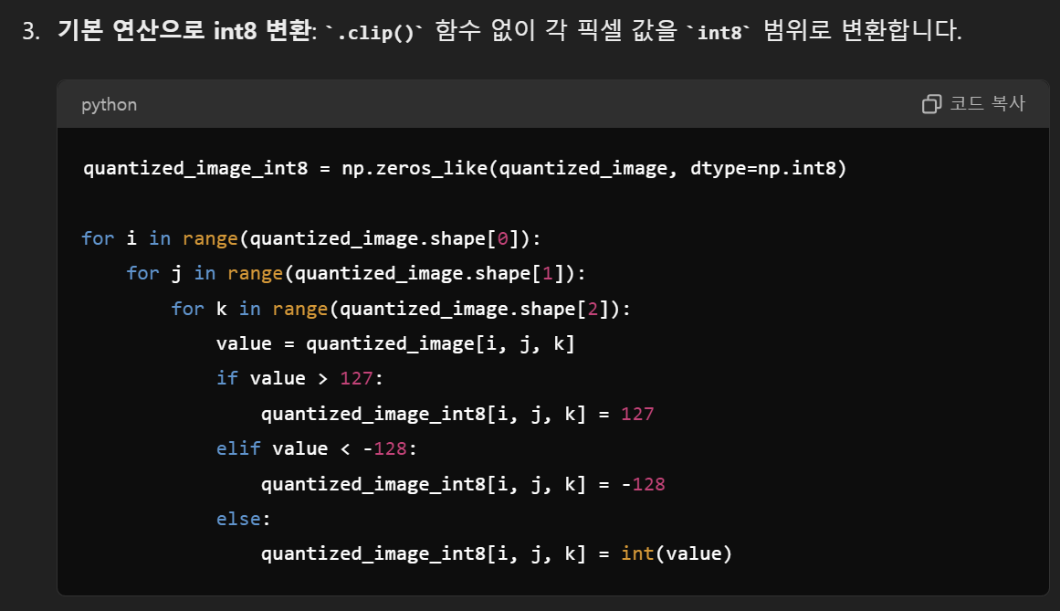
(5) About Quantization
Reference Code (input data)

Slide 18
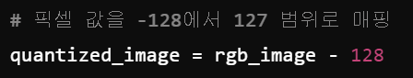
(5) About Quantization
Reference Code without normalization (input data)

Slide 19
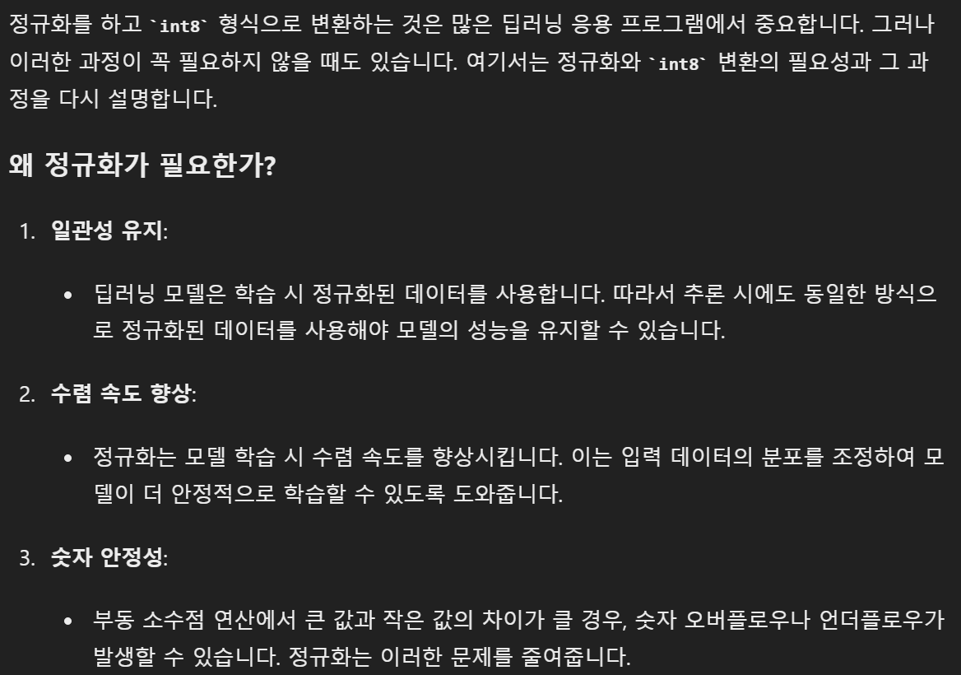
(5) About Quantization
Why we take normalization?

Slide 20
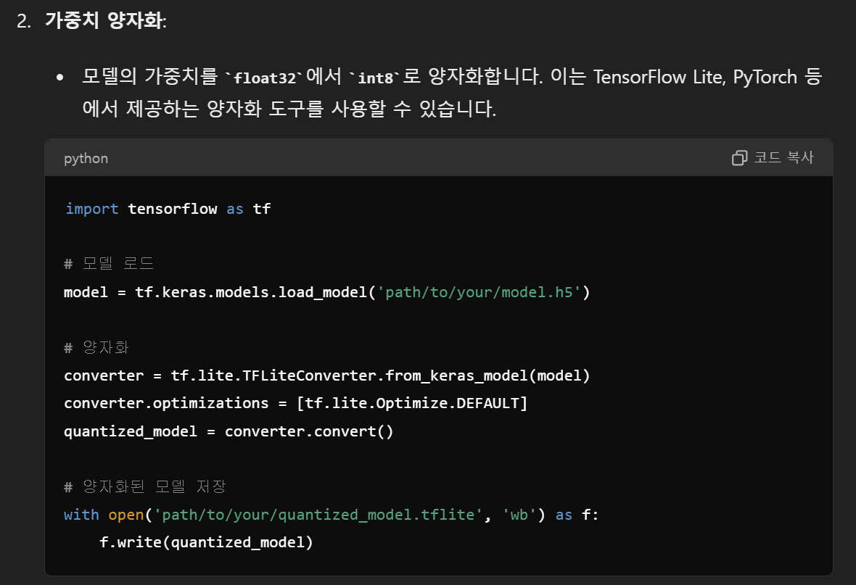
(5) About Quantization
Reference Code (weight)

Slide 21
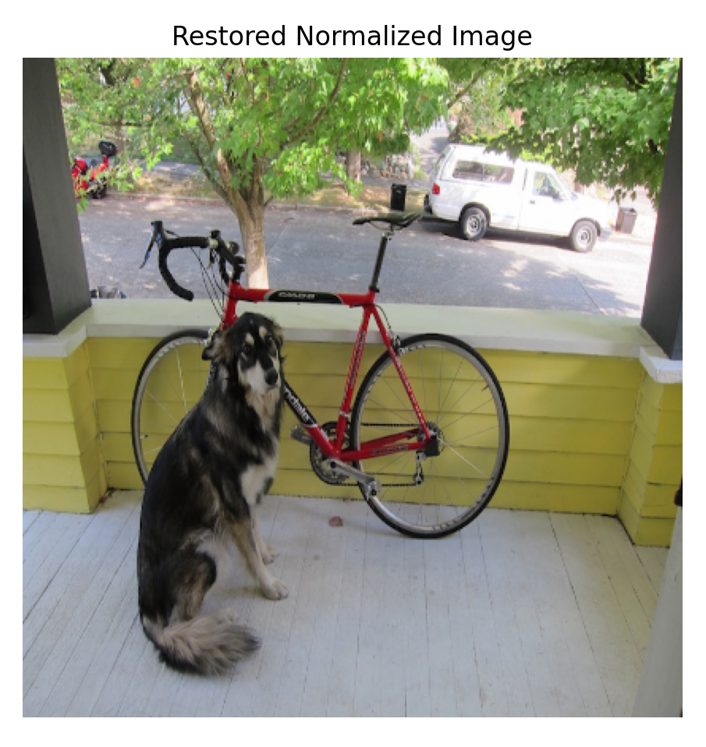
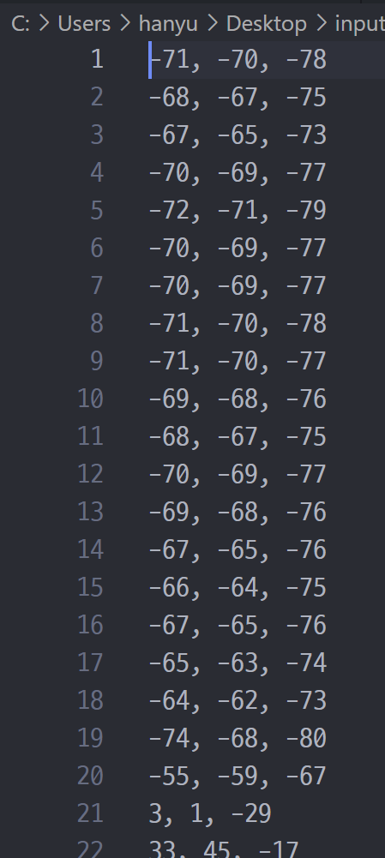
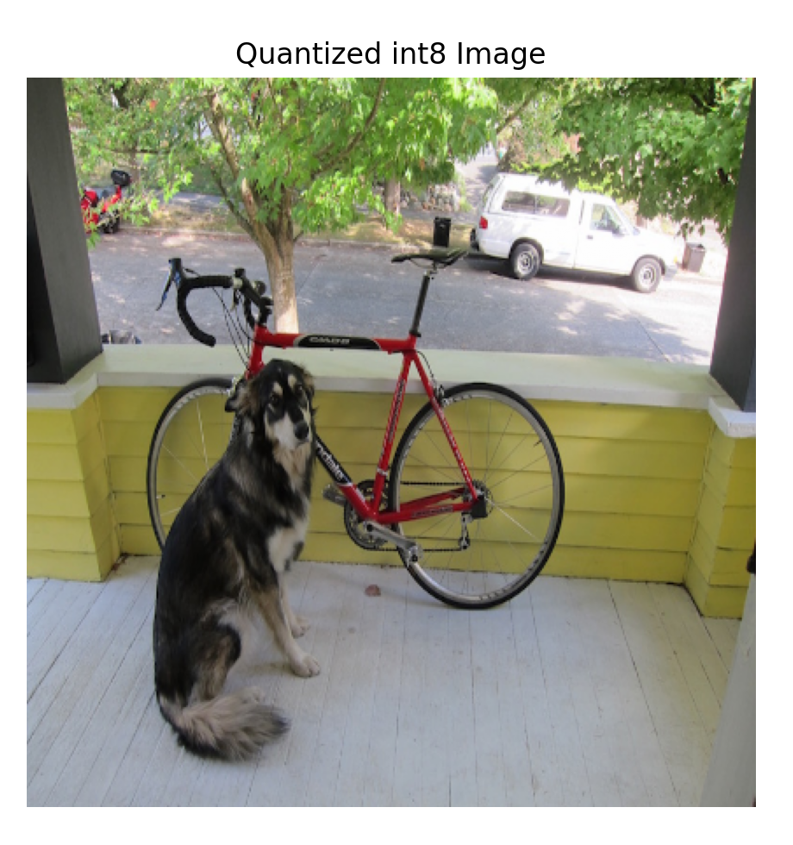
(6) About INT8 Dataflow
data visualization
input image dataflow
normalization
quantization
input img

Slide 22
(6) About INT8 Dataflow
data visualization
our goal
normalization
quantization
input img
FPGA YOLO Operation

Slide 23
(6) About INT8 Dataflow
Weight
구현 실패…

